Slide 1

Creating REST APIs with Spring MVC

Slide 2
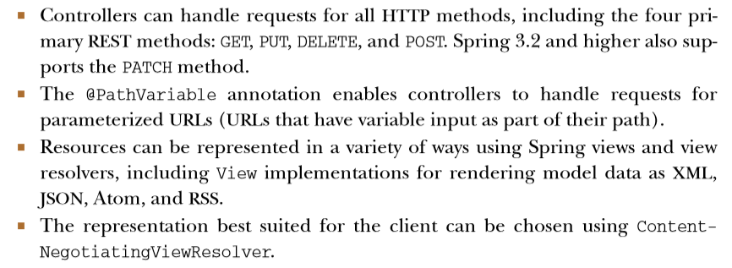
How Spring supports REST
Now, at version 4.0, Spring supports the creation of REST resources in the following ways:

Slide 3
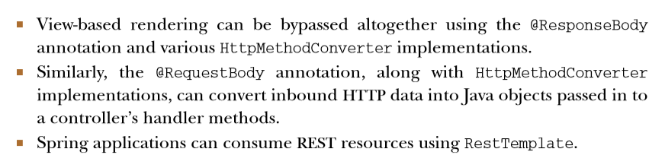
How Spring supports REST

Slide 4

Creating a REST endpoint

Slide 5
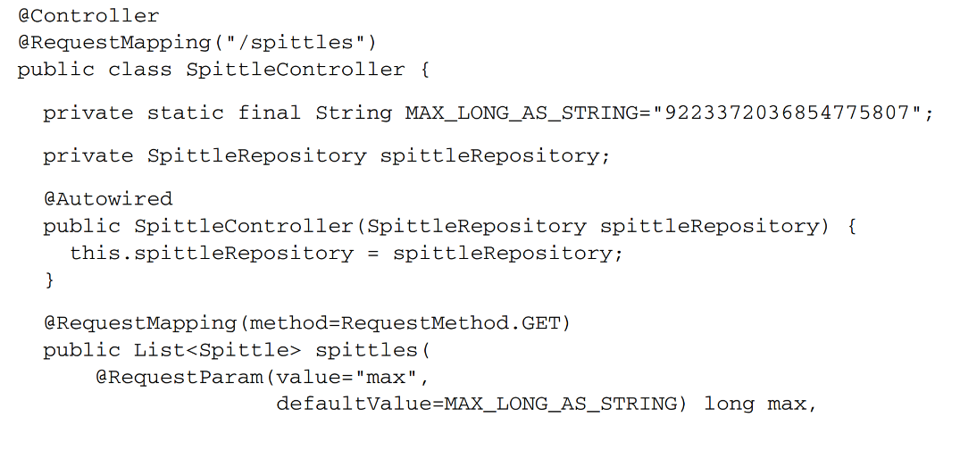
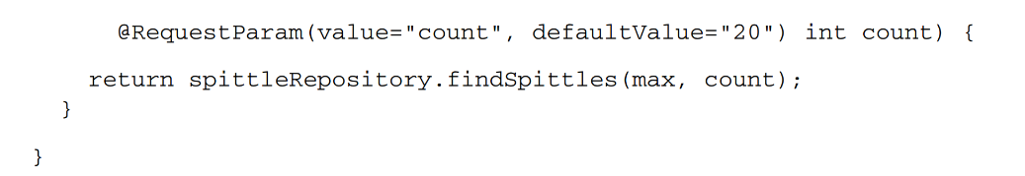
Creating a REST endpoint

Slide 6
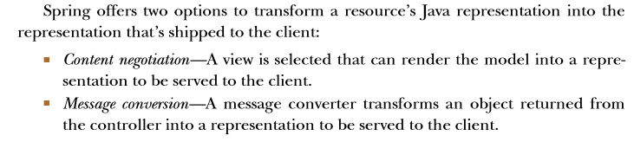
Creating a REST endpoint

Slide 7
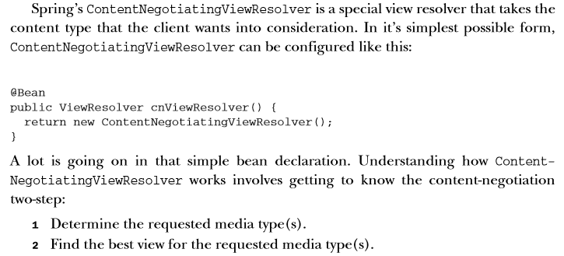
Negotiating resource representation

Slide 8
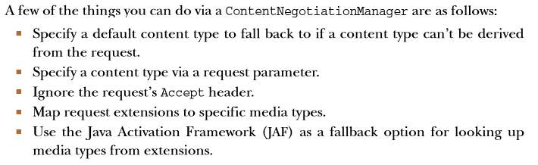
ContentNegotiationManager

Slide 9
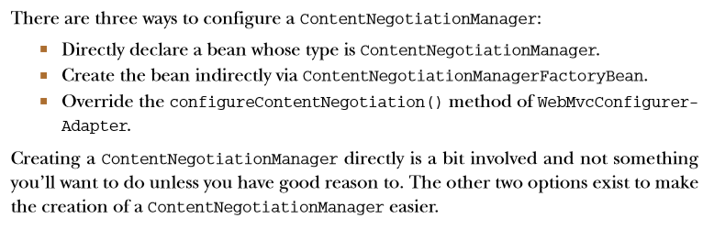
ContentNegotiationManager

Slide 10
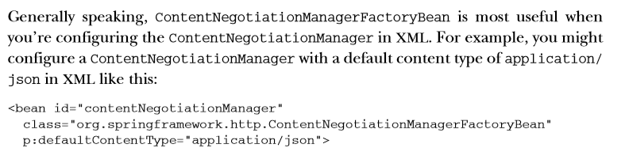
ContentNegotiationManager

Slide 11
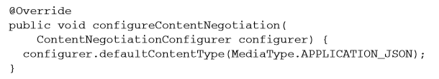
ContentNegotiationManager
In Java configuration:

Slide 12
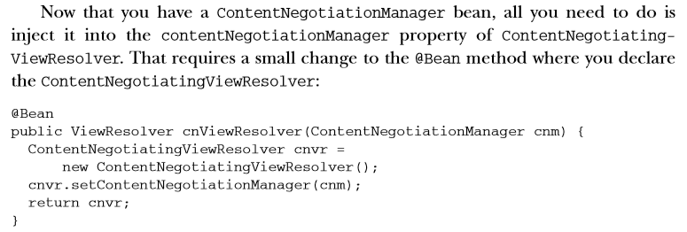
ContentNegotiationManager

Slide 13
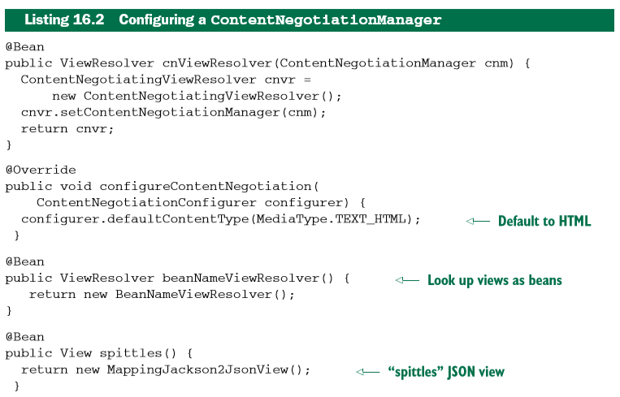
ContentNegotiationManager

Slide 14
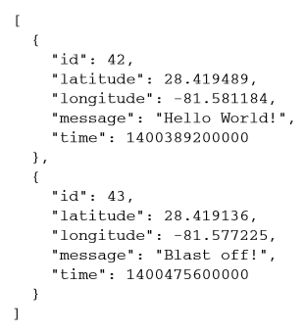
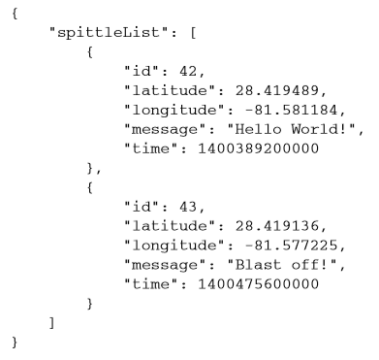
ContentNegotiatingViewResolver
Client expection: actual response:

Slide 15
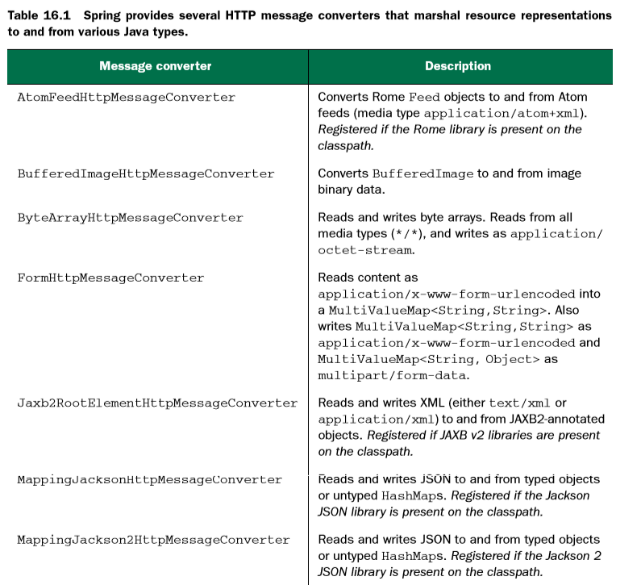
Working with HTTP message converters

Slide 16
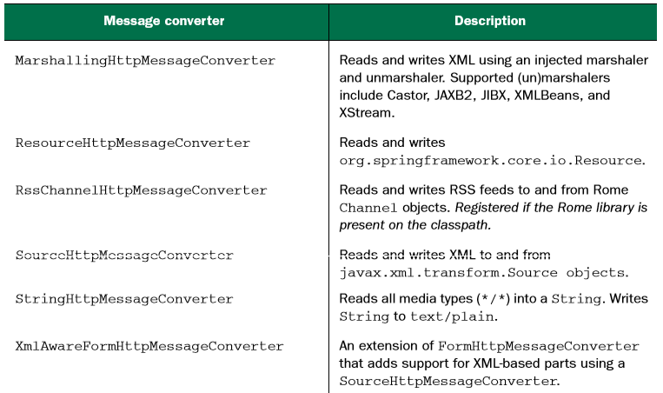
Working with HTTP message converters

Slide 17
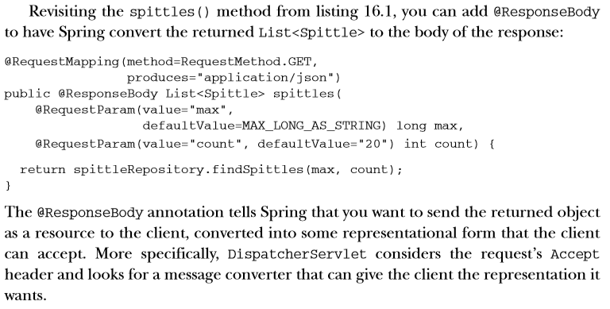
Returning resource state in the responce body

Slide 18
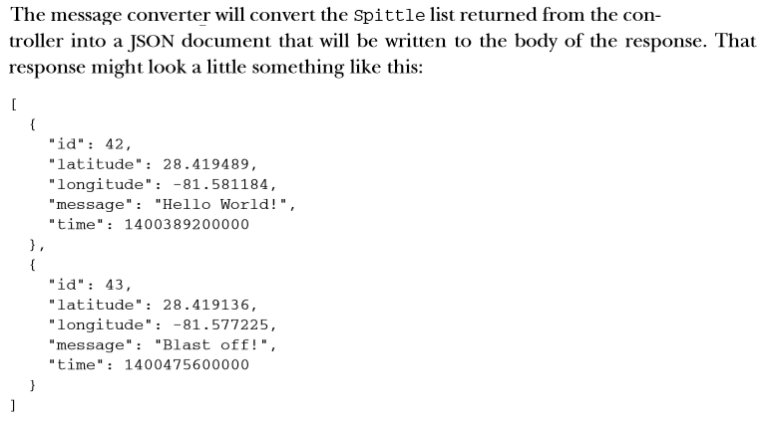
Returning resource state in the responce body

Slide 19
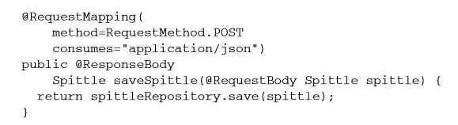
Receiving resource state in the request body

Slide 20
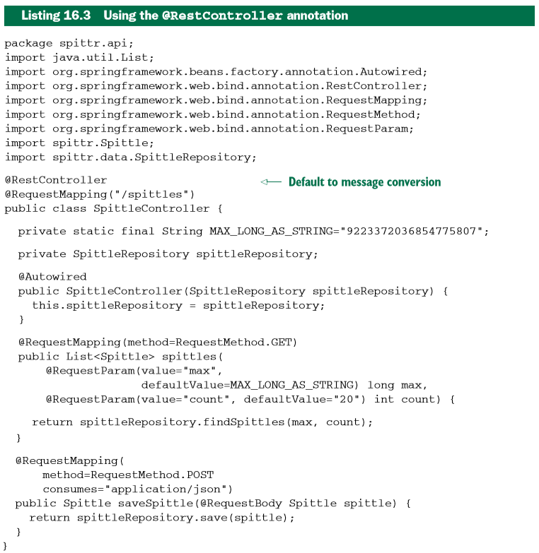
Defaulting controllers for message concersion
The key thing to notice in listing 16.3 is what’s not in the code. Neither of the handler methods are annotated with @ResponseBody.
But because the controller is annotated with @RestController, the objects returned from those methods will still go through message conversion to produce a resource representation for the client.

Slide 21
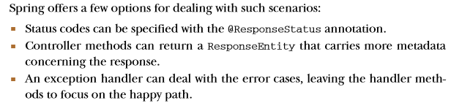
Communicating errors to the client

Slide 22
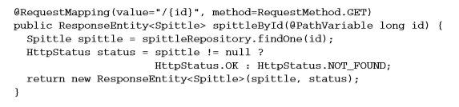
Working with ResponseEntity

Slide 23
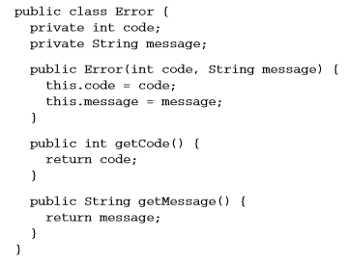
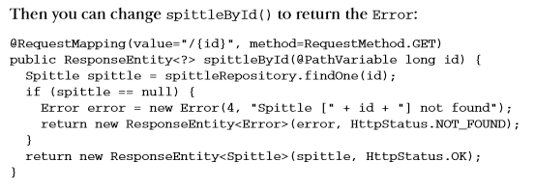
Working with ResponseEntity

Slide 24
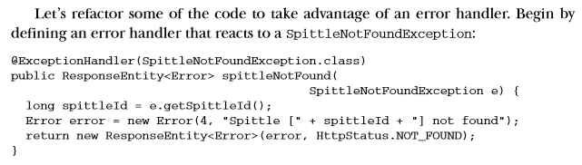
Handling errors

Slide 25
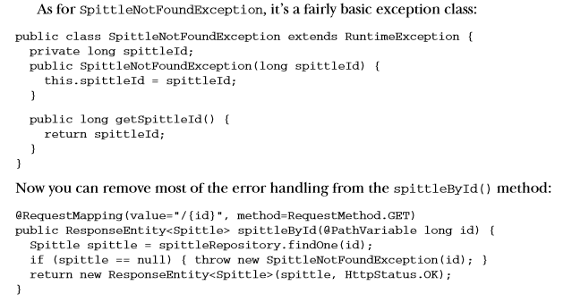
Handling errors

Slide 26
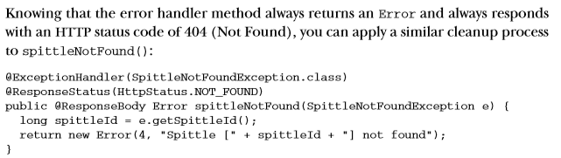
Handling errors

Slide 27
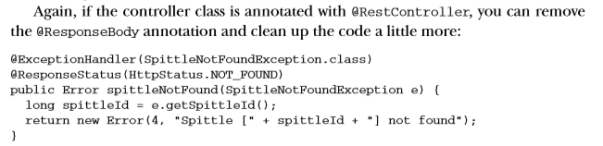
Handling errors

Slide 28
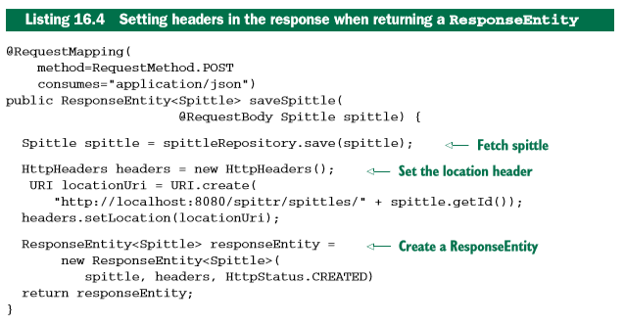
Setting headers in the response

Slide 29
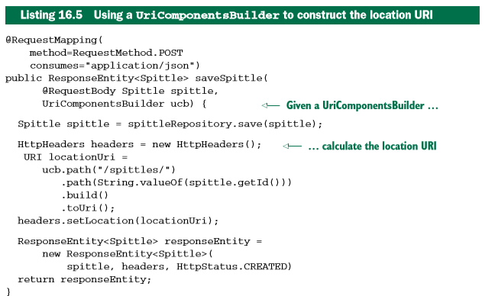
Setting headers in the response

Slide 30
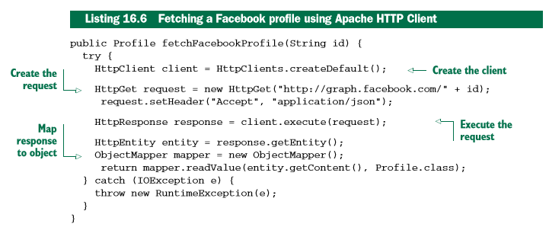
Consuming REST resources

Slide 31
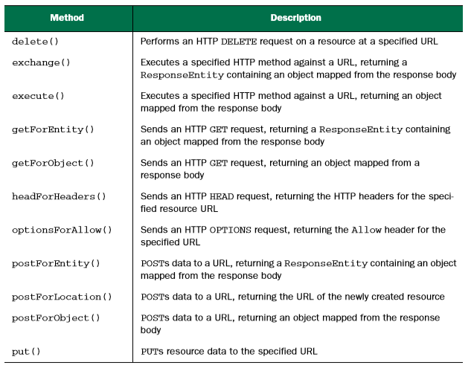
Exploring RestTemplate´s operations
RestTemplate defines 36 methods for interacting with REST resouces

Slide 32
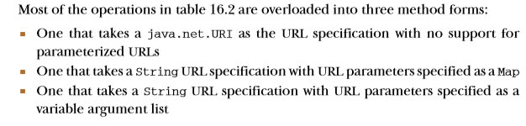
Exploring RestTemplate´s operations

Slide 33
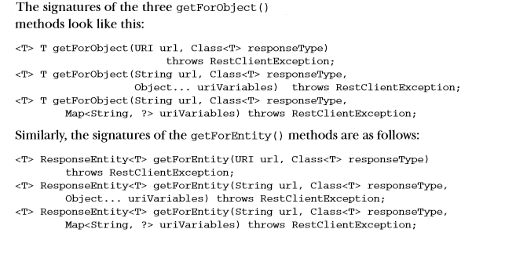
GETting resources

Slide 34
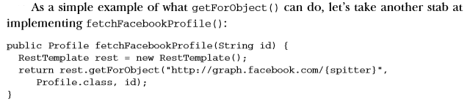
Retrieving resources

Slide 35
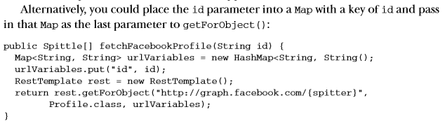
Retrieving resources

Slide 36
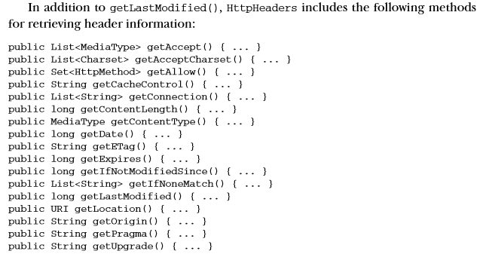
Extracting response metadata

Slide 37
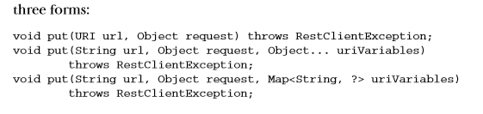
PUTting resources

Slide 38
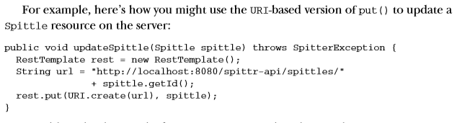
PUTting resources

Slide 39

PUTting resources

Slide 40
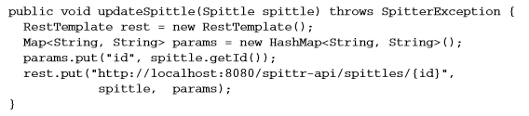
PUTting resources

Slide 41
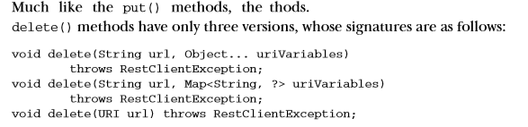
DELETEing resources

Slide 42
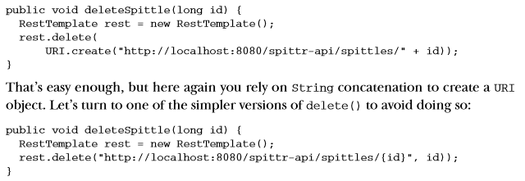
DELETEing resources

Slide 43
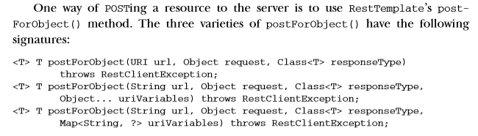
Receiving object responses from POST requests

Slide 44
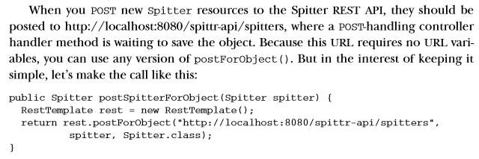
Receiving object responses from POST requests

Slide 45
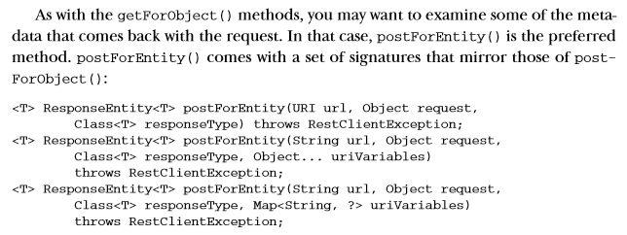
Receiving object responses from POST requests

Slide 46
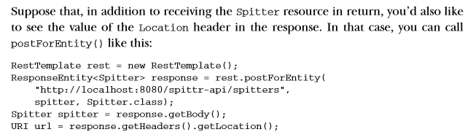
Receiving object responses from POST requests

Slide 47
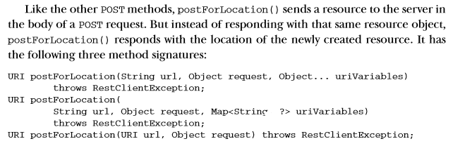
Receiving a resource location after a POST request

Slide 48
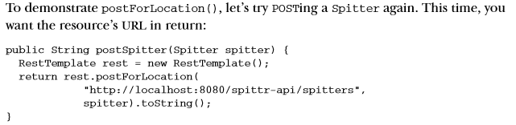
Receiving a resource location after a POST request

Slide 49
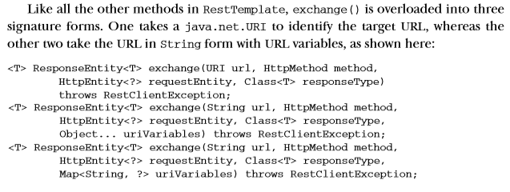
Exchanging resources

Slide 50
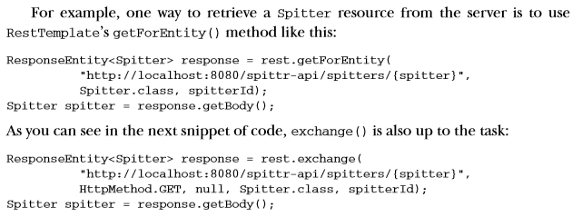
Exchanging resources

Slide 51

Exchanging resources

Slide 52

Exchanging resources

Slide 53

Exchanging resources

Slide 54

Exchanging resources

